Slide 1
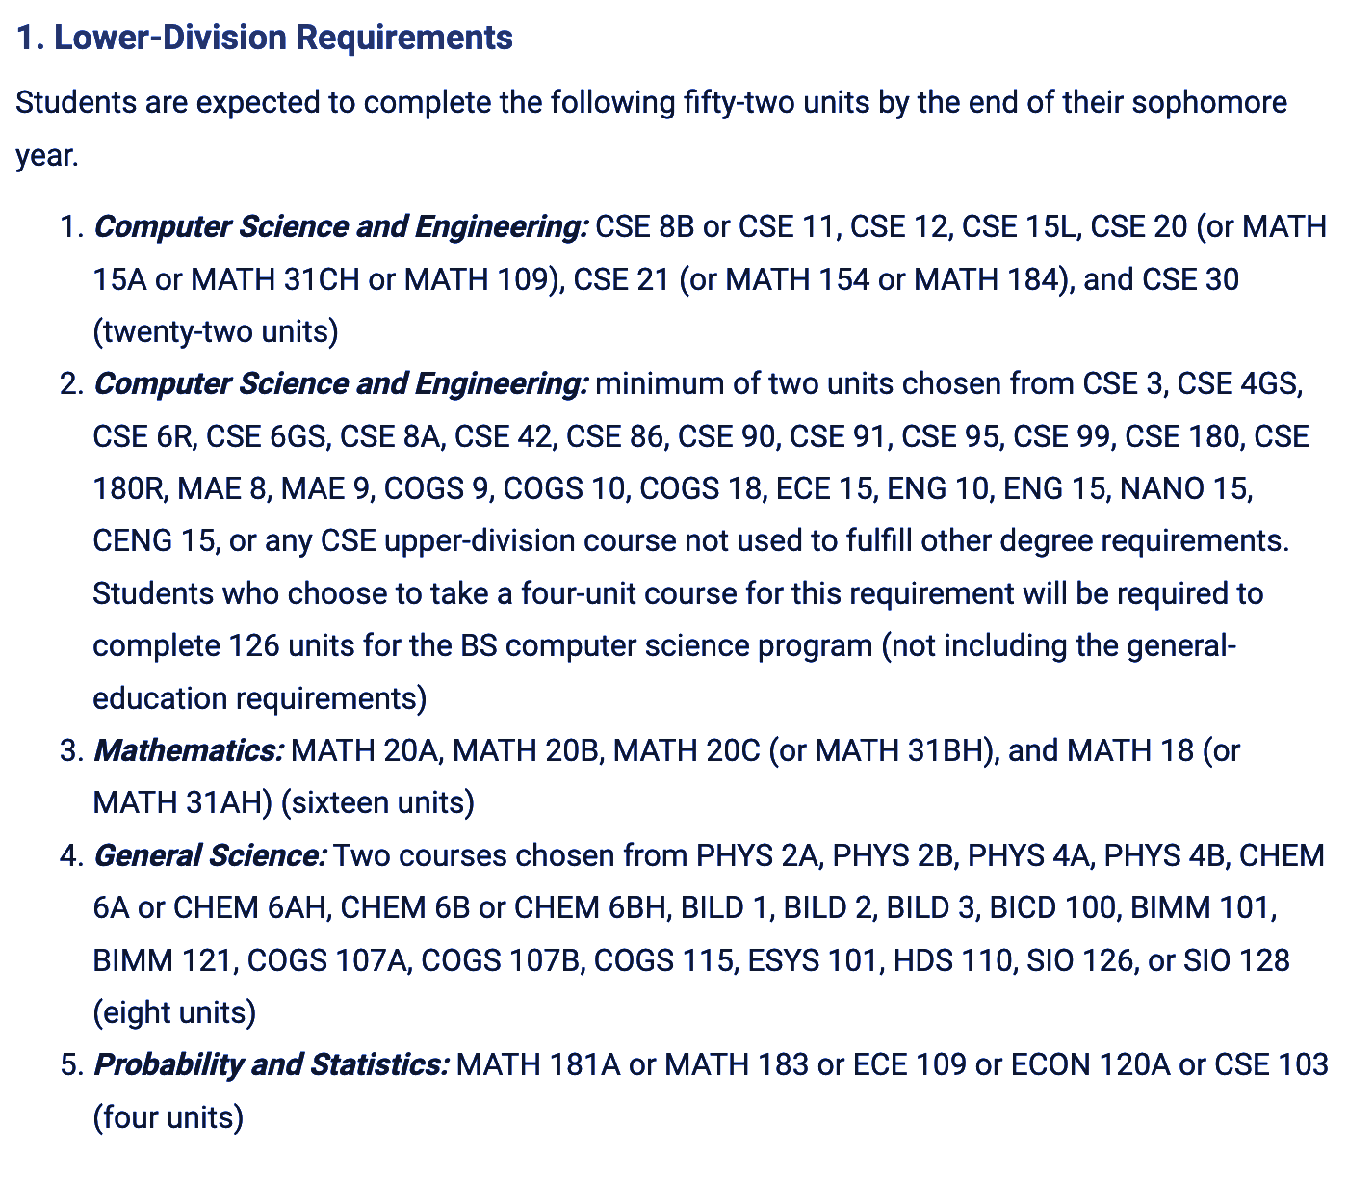



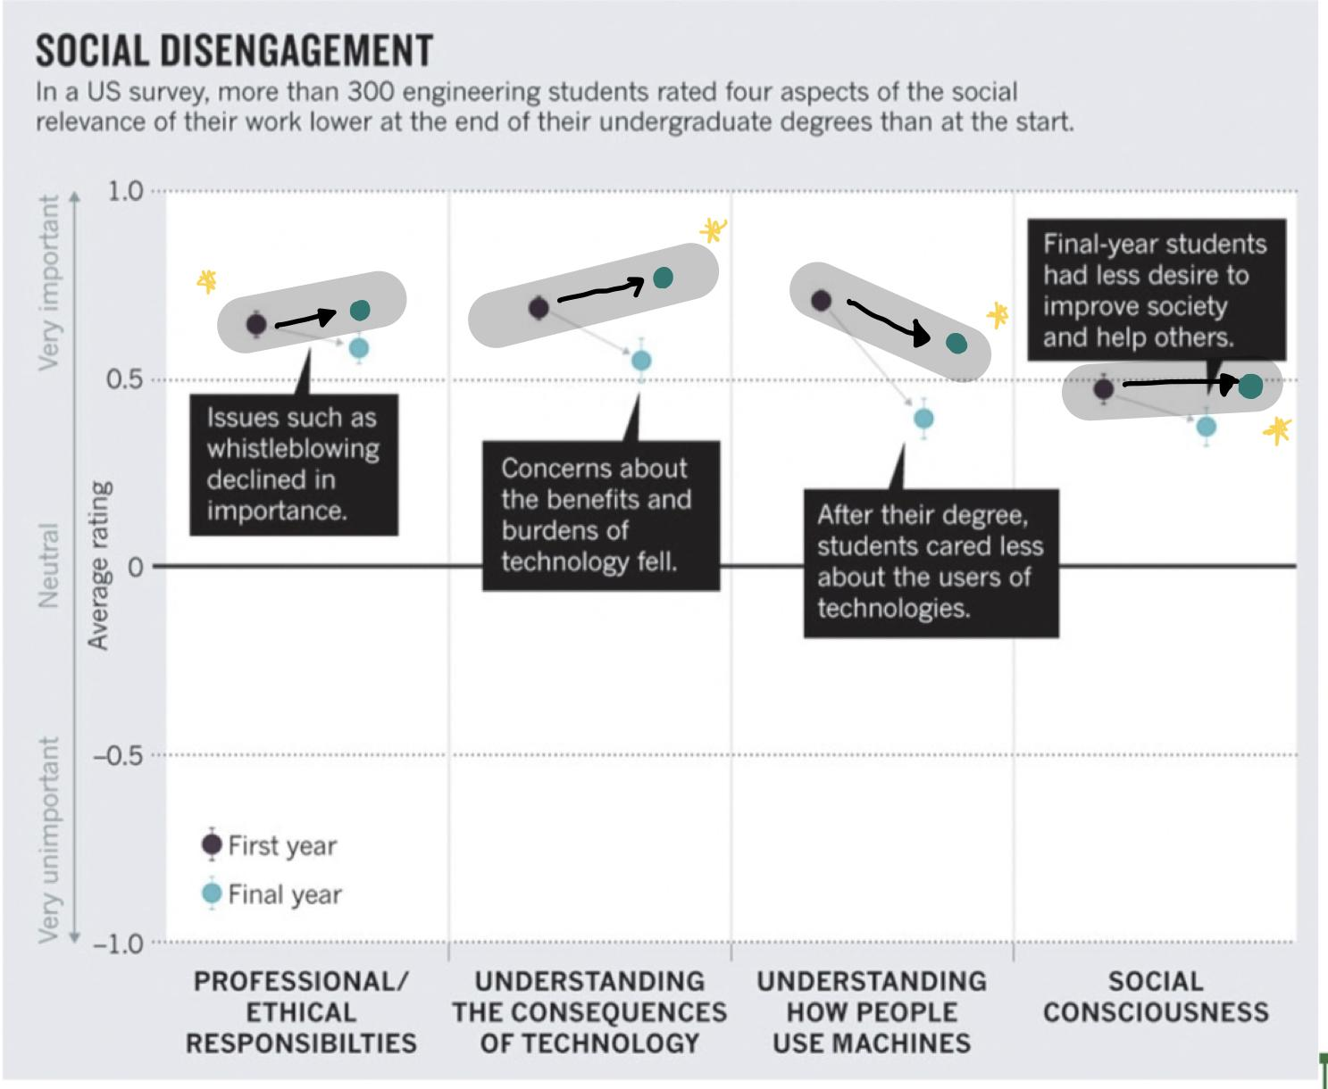
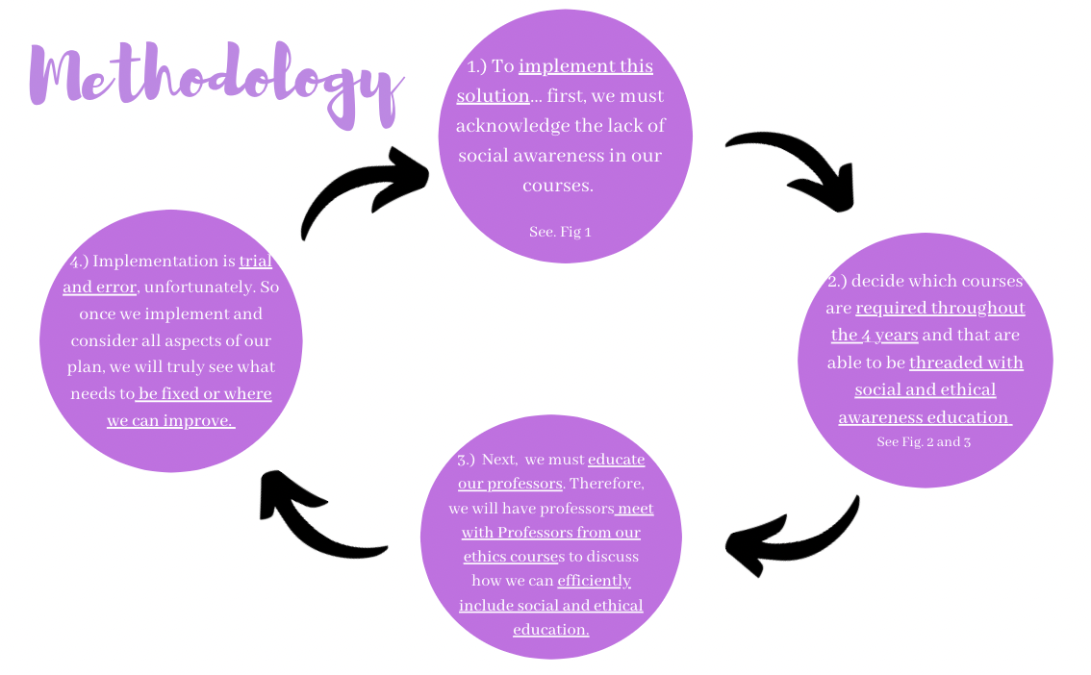
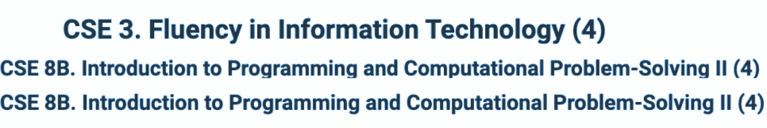
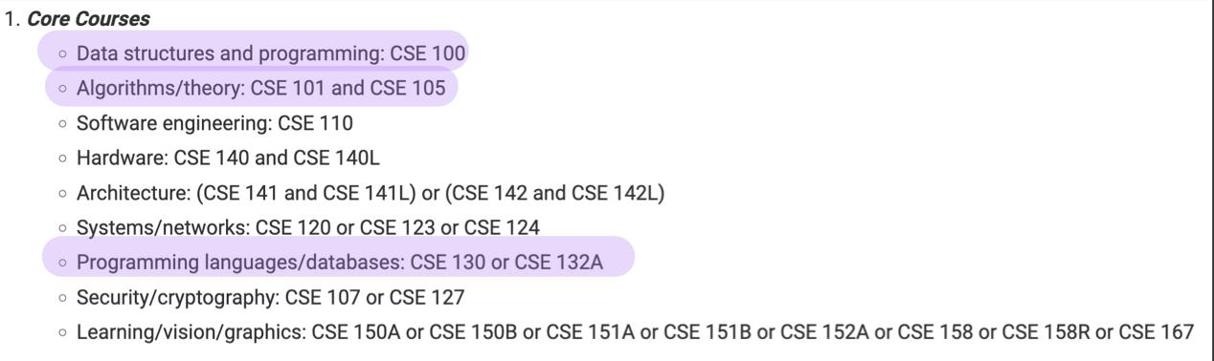
Computer Scientist need Social and Ethical Awareness too
By Nadia Sanchez
WCWP 10B
Introduction
Solution
Conclusion and Results
Technology has grown over the years, and so has its use in our world. It has become used in many aspects in our life that we ourselves even know that its used, specifically the use of Algorithms. The use of algorithms in
social aspects of our world can lead to more problems than actually solving any as there intended purpose.
For example the use of Algorithms for policing and our justice systems. Such algorithms which are meant to benefit our community end up harming communities
In order to tackle the problem we must first begin at the root of the problem…
Results!
As mentioned before this is trial and error, although it will be harder to see results instantly. Throughout the years we hope to see
significance change in the usage of Social and ethical Awareness within algorithms after students graduate.
To teach students that there creations are harmful and prevent students from continuing to implement racially biased algorithms such as Predpol.
Be able to acknowledge the social aspects of our communities and implement algorithm that are efficient to the way our society
Conclusion!
The lack of humanities and social awareness in science in general is concerning because it allows students to just create and create, without considering our society's needs. The implementation of social and ethical education for computer science majors will tackle biased algorithms. So, when they are creating such algorithms they are stopping and consider how to effectively create this and will it truly be beneficial.
The Universities !
The graph demonstrates social disengagement as students graduate in the US… We wish to seen an increase similarly to the one I implemented
QR code sends you to website of OurWorldinData.org , scroll to see chart from 1860- 2019, demonstrating the technological advances in households
The solution I am proposing is that Universities with Computer Science majors should begin threading their general computer science courses with Ethical and Social Awareness throughout their 4 years.. This will involve more than just discussing Social awareness for one unit. students will engage with the idea, having assignments and quizzes to assure that students are actually understanding and comprehending the importance of social and ethical awareness.
Fig. 1: demonstrating the lack of Social and Ethic courses in lower Division requirements
Problem
Fig. 2 Lower Division Courses that can be threaded with social and Ethical education
The lack of social and ethical awareness allows for the creation of racially biased Algorithms.
An example of such is, Prepol. Predol is a predictive crime model that uses geography to help policing (O'Neill)
due to the lack of data there was a loop on communities with Majority of people of Color because of nuisance crimes
The lack of social awareness, many of our communities suffer from redlining causing algorithms made for communities that are meant to be equal and fair be applied incorrectly.
Acknowledgements
Cathy O’Neill “ Civilian Casualties: Justice In Age of Big Date “ chp 5
OurWorldinData. org
https://catalog.ucsd.edu/courses/CSE.html
Erik A. Cech “Education Embed social awareness in science Curricula”
Fig 3upper division courses to thread social and ethical education

